Slide 1
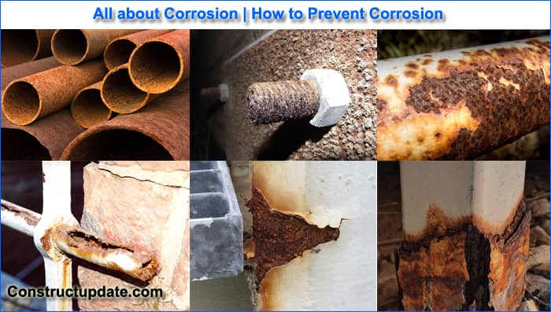
UNIT IV CORROSION AND ITS CONTROL
1.Corrosion is a natural chemical or electrochemical process in which a refined metal gradually transforms into a more stable compound such as an oxide, hydroxide, or sulphide-through reactions with its environment.
2.This transformation results in the degradation of the metal's physical and mechanical properties, often weakening its structure and impairing its performance

Slide 2
Definition
Corrosion of metals is defined as the natural deterioration of metals resulting from their chemical, electrochemical, or biochemical reactions with the surrounding environment.
Example Rusting of iron
Classification of Corrosion
Based on the environment to which it is exposed, corrosion is divided into two types
Dry or chemical corrosion
Wet or electrochemical corrosion

Slide 3
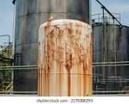
Chemical corrosion
Chemical corrosion refers to the gradual deterioration of a metal surface caused by a direct reaction with a dry or non-electrolytic chemical environment, such as reactive gases such as oxygen(O), hydrogen (Ha), hydrogen sulfide (H.S), sulfur dioxide (SO₂), nitrogen (Na) or non-conductive liquids, without involving any electrochemical processes.
The three main types of chemical corrosion are as follows
Oxidation corrosion or corrosion by oxygen
Corrosion by hydrogen
Liquid metal corrosion

Slide 4
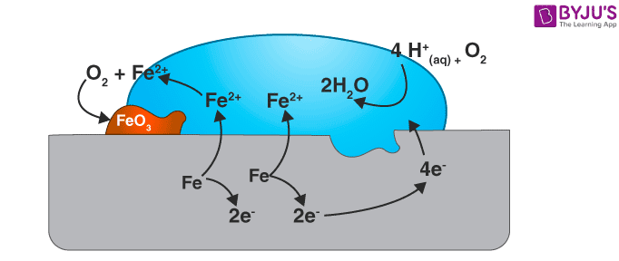
Oxidation corrosion or corrosion by oxygen
oxidation corrosion is a form of chemical corrosion in which a metal reacts with oxygen usually at elevated temperatures in the absence of moisture-resulting in the formation of a metal oxide layer on its surface.
(i) Oxidation occurs at the metal surface, resulting in the formation of metal ions
M −−−−− M²⁺ + 2e⁻
(ii) Oxygen is reduced to oxide ions by accepting electrons released from the metal
¹⁄2O₂ + 2e⁻ −−−−− O²
(iii)The oxide sons combine with metal ions to produce a metal oxide layer on the surface.
M + ¹⁄2O₂ −−−−− M²⁺ + O²⁻ ≡ MO (Metal-oxide film).

Slide 5
The nature of oxide film formed on the metal surface plays an important role in oxidation corrosion.
1.Stable oxide layer
A stable oxide layer is a fine-grained in structure, and gets adsorbed tightly to the metal surface. Such a layer is impervious in nature and stops further oxygen attack through diffusion. Such a film behaves as a protective coating and no further corrosion can develop.
Example: Oxides of Al, Sn, Pb, Cu, etc., are stable oxide layers.
2.Unstable oxide layer
Unstable oxide layer is mainly produced on the surface of noble metals, which decomposes back into the metal and oxygen.
Metal oxide —->Metal+ Oxygen
Example: Oxides of Pt, Ag, etc., are unstable oxide layers.
3. Volatile oxide layer
The oxide layer volatilizes as soon as it is formed, leaving the metal surface for further corrosion.
Example: Molybdenum oxide (MoO₃) is volatile.

Slide 6
4. Protective (or) Non-Protective oxide film (Pilling-Bedworth rule)
(i) According to Pilling-Bedworth rule, if the volume of the oxide layer formed is less than the volume of the metal, the oxide layer is porous and non-protective.
Example :The volume of oxides of alkali and alkaline earth metals such as Na, Mg, Ca, etc., is less than the volume of the metal consumed. Hence the oxide layer formed is porous and non-protective.
(ii) On the other hand, if the volume of the oxide layer formed is greater than the volume of the metal, the oxide layer is non-porous and protective.
Example :The volume of oxides of heavy metals such as Pb, Sn, etc., is greater than the volume of the metal. Hence the oxide layer formed is non-porous and protective.
Pilling-Bedworth ratio
The ratio of the volume of the metal oxide formed to the volume of the metal consumed is called “Pilling-Bedworth ratio”.
If the PB ratio is slightly greater than 1, the metal oxide layer will be protective and non porous.

Slide 7
(ii) Corrosion by hydrogen:
Hydrogen corrosion refers to the degradation of metals resulting from exposure to hydrogen hydrogen-containing substances.
1. Hydrogen embrittlement (at ordinary temperature)
When metals contact to H₂S at ordinary temperature causes evolution of atomic hydrogen.
Fe + H₂S −−−−− FeS + 2H
This atomic hydrogen diffuses readily into the metal and collects in the voids, where it recombines to form molecular hydrogen.
H + H −−−−− H₂↑
Collection of these hydrogen gases in the voids develop very high pressure, which causes cracks and blisters on metal.
Thus, the process of formation of cracks and blisters on the metal surface, due to high pressure of hydrogen gas is called hydrogen embrittlement

Slide 8
2. Decarburisation (at higher temperature)
The reduction of carbon content in steel is known as decarburization.
when steel is exposed to a hydrogen-rich environmment at high temperatures, atomic hydrogen is generated.
H₂ −−−−− 2H
Atomic hydrogen reacts with the carbon in the steel to form methane gas (CH4).C + 4H −−−−− CH₄↑
Collection of these gases in the voids develop very high pressure, which causes cracking. Thus the process of decrease in carbon content in steel is termed as “decarburisation” of steel.
Liquid metal corrusion:
(iii) when a solid metal is exposed to a liquid metal, resulting in processes such as dissolution, penetration, or alloy formation at their interface. This interaction can significantly weaken the structural integrity of the solid metal particularly at high temperatures
The gradual absorption or breakdown of a solid metal when it comes into contact with a liquid metal.
The infiltration of a liquid metal into the structure of a solid metal

Slide 9
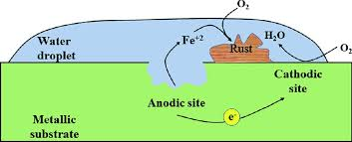
Electrochemical corrosion
Electrochemical corrosion occurs under the following two conditions
When two dissimilar metals come into contact in the presence of moisture or an aqueous solution.
When a single metal is exposed to an electrolyte containing uneven concentrations of oxygen across surface
MECHANISM
Metal dissolution or corrosion always takes place at the anode
M −−−−− M²⁺ + 2e⁻
The redaction reaction occurs at the cathode and varies based on the nature of the corrosive environment.
Is an acidic environment, hydrogen gas is released at the cathode
2H⁺ + 2e⁻ −−−−− H₂↑
In a neutral or slightly alkaline environment, hydroxide ions are formed
¹⁄2O₂ + 2e⁻ + H₂O −−−−− 2OH⁻

Slide 10
Types of mechanism
Types of mechanism
(1) Hydrogen evoulation type corrosion
(ii) Absorption of oxygen or hydroxide ion type corrosion
(1) Hydrogen evoulation type corrosion
All metals positioned above hydrogen in the electrochemical series tend to dissolve in acidic solutions, releasing hydrogen gas in the process
At anode: Iron dissolves by forming Fe²⁺ ions while releasing electrons
Fe −−−−− Fe²⁺ + 2e⁻ (oxidation)
At cathode: These electrons flow from the anode to the cathode, where H ions are reduced, resulting in the evolution of hydrogen gas.
2H⁺ + 2e⁻ −−−−− H₂↑ (reduction)

Slide 11
(ii) Absorption of oxygen or hydroxide ion type corrosion
In this form of corrosion, the cathodic reaction produces hydroxide ions (OH") as a result of the reduction of dissolved oxygen in the presence of water.
At anode : Iron dissolves by forming Fe2+ ions while releasing electrons
Fe −−−−− Fe ⁺ + 2e⁻ (oxidation)
At cathode :The released electrons travel from the anode to the cathode through the metal, where they are absorbed by dissolved oxygen, resulting in the formation of Hydroxide ions
¹⁄2O₂ + H₂O + 2e⁻ −−−−− 2OH⁻
The Fe²⁺ and OH⁻ ions combine to form ferrous hydroxide as a precipitate Fe2018-FeO
Fe²⁺ + 2OH⁻ −−−−− Fe(OH)₂↓
In the presence of sufficient oxygen, this ferrous hydroxide to readily oxidised to ferric Hydroxide
4Fe(OH)₂ + O₂ + 2H₂O −−−−− 4Fe(OH)₃

Slide 12
Types of electrochemical corrosion
Electrochemical corrosion can be categorized into two types
Galvanic corrosion
Differential aeration or concentration cell corrosion
(1)Galvanic corrosion:
Galvanic corrosion, also called bimetallic corrosion, takes place when two dissimilar metals are in electrical contact and exposed to an electrolyte like water, moisture, or soil .
In this setup, one metal act as the anode and corrodes more rapidly, while the other serves as the cathode and remains protected

Slide 13
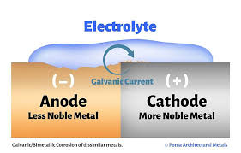
Zn-Cu bimetallic couple
zinc is more reactive and preferentially dissolves instead of copper.
As a result, zinc functions as the anode and undergoes corrosion, while copper serves as the cathode.
Fe-Cu bimetallic couple
Similarly in Fe-Cu bimetallic couple, iron being the more active metal dissolves in preference to copper. In this case, iron acts as anode and undergoes corrosion and copper acts as cathode.
Example. Steel screw in a brass.
Marine hardwere corrodes due to this type of corrosion Iron becomes anodic (higher position in EMF acts a cathode and is not corroded.

Slide 14
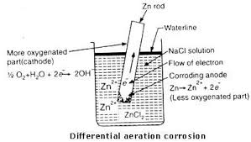
Differential aeration or concentration cell corrosion
Differential aeration corrosion is a form of electrochemical corrosion that arises when different area of the same metal surface are subjected to unequal oxygen concentrations. The area with lower Oxygen concentration acts as the anode and undergoes Corrosion, while the area with higher oxygen concentration becomes the cathode and remains protected.
At Anode: Less aerated and corrosion occurs
M −−−−− M²⁺ + 2e⁻
At cathode: More aerated and OH ions are produced.
¹⁄2O₂ + H₂O+ 2e⁻ −−−−− 2OH⁻

Slide 15
Examples for Differential aeration corrosion
(a)Pitting or localised corrosion.
Pitting corrosion is an electrochemical corrosion that results in the development of small, deep cavities or pits on a metal surface Corrosion occurs more rapidly when the cathodic area is large and the anodic area is small
(b) Crevice corrosion
Crevice corrosion is a type of localized electrochemical corrosion that takes place in tight, confined faces where oxygen or fluid access is limited. The interior of the crevice, lacking oxygen. act as the anode and undergoes corrosion, while the outer surface with abundant Oxygen serves as the cathode
(c) Pipeline corrosion.
Buried pipelines or cables that pass through different soil types such as from less-aerated clay ,to more aerated sandy soil can experience corrosion as a result of differential aeration
(d) Corrosion on wire fence
In a wire fence, the points where the wires intersect receive less exposure to air compared to the rest of the structure. As a result, there low-aeration area become more susceptible to corrosion making wire makings common sites for deterioration

Slide 16
Factors Influencing the Rate of Corrosion
Nature of the metal
(i) Purity of the metal
(ii) Relative area of electrodes
(iii) Position in galvanic series
(iv) Over voltage
(v) Nature of the surface film
vi) Nature of corrosion product
Nature of the environment
i)Temperature ii)Humidity iii)pH

Slide 17
(i) Purity of the metal
A metal that is 100% pure is generally resistant to all types of corrosion.Even trace amounts of impurities can trigger galvanic corrosion when the metal is exposed to a corrosive environment. As the level of impurities increases, the rate of corrosion accelerates
For example, the corrosion rate of aluminium in hydrochloric acid (HCI) demonstrates this effect
(ii) Relative area of electrodes
Corrosion mainly takes place at anodic regions due to the oxidation of metal. The rate at which this corrosion progresses is greatly affected by the size of the cathodic area.
A larger cathodic area speeds up the corrosion process because it demands more electrons for reduction, which must be supplied by the smaller anodic area. This increased electron flow intensifies the metal's degradation at the anode.

Slide 18
(iii) Position in galvanic series
The corrosion rate is affected by the relative placement of metals in the electromotive force (emf) series. A larger gap between their positions corresponds to a faster corrosion rate
In particular, metals located above hydrogen in the emf series are more prone to corrosion, that is, metals with lower reduction potentials tend to corrode more quickly
(iv) Over voltage
The overvoltage of a metal in a corrosive environment is inversely related to the rate of corrosion.

Slide 19
(v) Nature of the surface film
The type of film that forms on a metal's surface plays a key role in determining the severity of corrosion
For alkali and alkaline earth metals, the oxide film is porous and non-protective, resulting in a higher and continuous corrosion rate
For heavy metals, the oxide film is dense and non-porous, serving as a protective barrier
if the corrosion products on the metal surface are soluble in the surrounding environment, corrosion proceeds more rapidly.
vi) Nature of corrosion product
When the corrosion product dissolves in the corrosive medium, the corrosion rate increses Similarly, if the corrosion product is volatile-like molybdenum trioxide (MoOs) on a molybdenu surface-the corresion process is also accelerated.

Slide 20
Nature of the environment
Temperature :The rate of corrosion increases with temperature, as the temperature rises, cortusion accelerates. This happens because higher temperatures boost the diffusion rate of ions, which in tim speeds up the electrochemical reactions responsible for corrosion
Humidity: Corrosion rates rise considerably in environments with high relative humidity in conditions, moisture acts as a solvent for gases like oxygen (O₂), carbon dioxide (CO₂), and s dioxide (50) found in the air. This leads to the formation of electrolytes, which are crucial for c a corrosion cell
pH of the corrosive environment: Corrosion occurs most rapidly in acidic environments, which generally more corrosive than neutral or alkaline conditions. However, certain metals like Al and Zn can also dissolve in alkaline media.

Slide 21
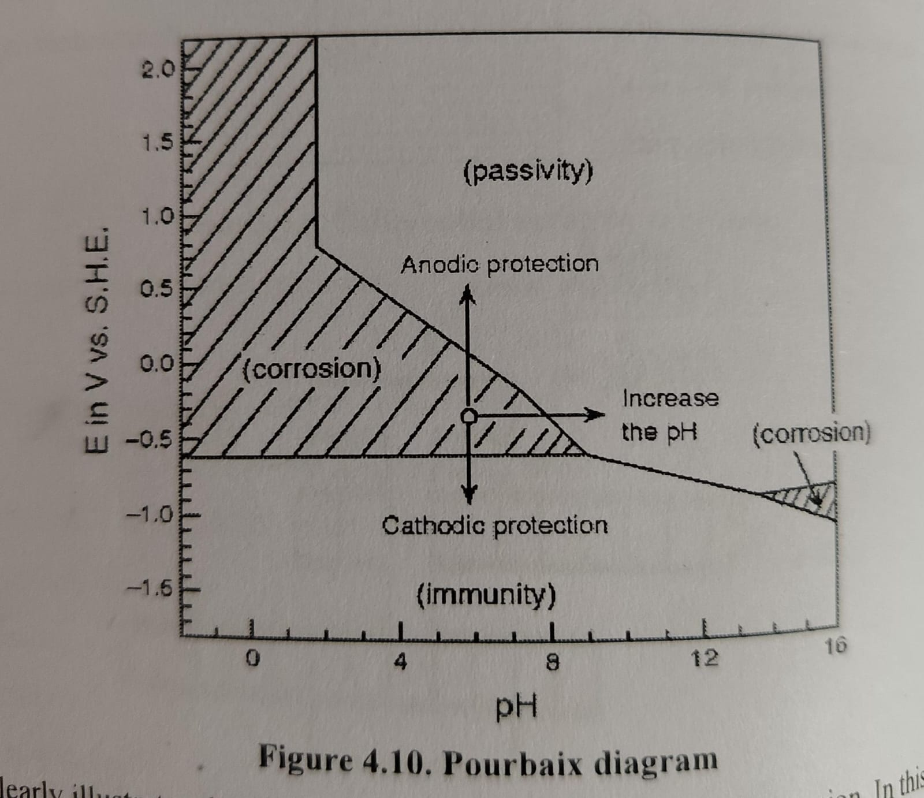
Figure - clearly illustrates the regions of passivity, immunity, and corrosion
In this diagram, point P represents a pH of 7 with a corresponding electrode potential of -0.4 V. It is evident that this point lies within the corrosion zone, indicating that under these conditions, iron undergoes corrosion rusting. The corrosion rate of iron can be altered by moving point P into either the immunity or pass regions This shift can be accomplished by adjusting the electrode potential as described below

Slide 22
This shift can be accomplished by adjusting the electrode potential as described below
If electrode potential adjusted to -0.8V apply an external current, iron becomes immune to corrosion
Applying a positive potential can reduce the corrosion rate, as it causes passive state.
The corrosion rate is highest when the PH is below 7, meaning the environment is acidic
The corrosion rate can be decreased by raising the PH of the solution through the addition of alkalis

Slide 23
iv)Impurities in the environment:
Atmospheric impurities from industrial exhaust gases-Sulphur dioxide (SO2),Sulphur trioxide (50%), nitrogen oxides (NOx), carbon dioxide (CO2), and carbon monoxide (CO)-along with fumes from hydrochloric acid (HCl) and sulphuric acid (H2SO4), lead to the formation of acidic electrolytes.
These acidic electrolytes greatly accelerate the electrochemical corrosion process
Presence of suspended particles.
Chemically active substances such as NaCl, (NH₄)₂SO₄
Chemically neutral substances
Chemically inactive substances (such as charcoal)
These pollutants accelerate corrosion by creating concentration cells

Slide 24
Corrosion Control
Corrosion control is a methods and techniques designed to prevent or reduce the degradation of metals caused by their interaction with the environment.
Cathodic protection
Cathodic protection is the process of reducing or preventing corrosion by converting the metal structure into the cathode of an electrochemical cell With no anodic areas present on the metal corrosion is prevented.
There are two methods used to apply cathodic protection to metallic structure
Sacrificial anodic protection (SAP)
Impressed current cathodic protection (ICCP)

Slide 25
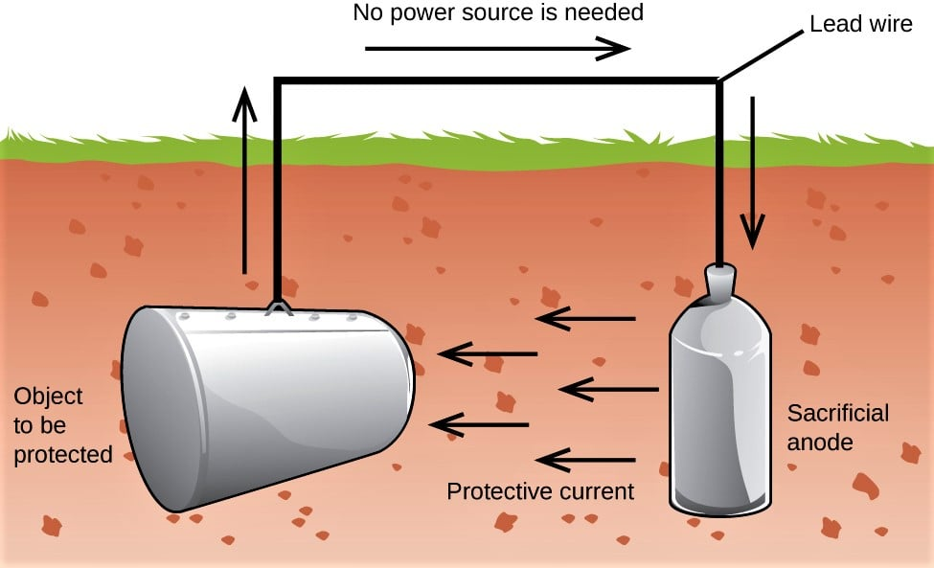
Sacrificial anodic protection method(SAP)
In this method, the metal structure to be protected is turned into a cathode by connecting it ta more active metal, known as the anodic metal. As a result, corrosion occurs only on the more active metal, protecting the original structure. This more active metal is called sacrificial anode.
When the sacrificial anode corrodes, it is replaced with a new one.
Common metal used as sacrificial anodes include magnesium, zinc, aluminium, and their alloys.

Slide 26
Advantages
Requires low cost for both installation and operation
Even the complex metal structures remain continuously protected as long as the sacrificial anode is present.
Can be used effectively against a wide variety of aggressive corrosive environments.
Disadvantage
A high initial current is necessary to activate the system
Anodes need to be replaced at regular intervals.
Uncoated areas are not protected by this method
Applications
Safeguards buried steel pipelines against corrosion caused by soil conditions
Widely applied to ship hulls, offshore structures, and submerged marine equipment to protect against seawater corrosion.
Employed in steel tanks located both underground and aboveground, particularly those storing water or chemicals.
Magnesium or aluminium anode rods are installed inside water heaters to prevent the tank from corroding

Slide 27
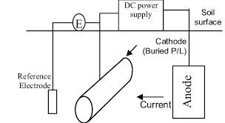
Impressed current cathodic protection (ICCP)
In this method, an impressed current is applied in the opposite direction to counteract the corrosion current, thereby converting the corroding metal from an anode to a cathode.
The impressed current comes from direct current sources such as batteries or rectifiers connected to an A.C. line, and uses an insoluble, inert anode like graphite, scrap iron, or platinum.
A sufficient direct current is supplied to the inert anode, which is buried in the soil or immersed in the corrosive environment and electrically connected to the metal structure that needs protection.
The anode is usually surrounded by a backfill material, such as coke breeze of gypsum, to improve electrical contact with the surrounding soil

Slide 28
Advantage
Ideal for safeguarding large metal structures such as pipelines, storage tanks, and offshore platforms.
The current can be adjusted to deliver optimal protection based on the specific environment and size of the structure.
It can offer protection in soils or environments with low electrical conductivity, where sacrificial anodes might be less efficient.
Disadvantages
The system requires a constant electricity supply, which can raise operational expenses and add complexity.
The installation and setup costs are typically higher than those of sacrificial anode systems.
the power supply is interrupted, protection ceases, leaving the metal vulnerable to corrosion
Applications
Protects the metallic sheathing of underwater communication and power cables from corrosion
Applied to large ships and vessels to guard against corrosion caused by seawater exposure.
Shields metal parts that are exposed to corrosive water conditions
Provides protection to offshore oil rigs, platforms, and submerged pipelines exposed to seawater

Slide 29
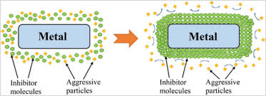
Corrosion inhibitors
Inhibitors are chemical substances that, when added in small quantities to a corrosive environment, significantly reduce the rate of metal corrosion.
Inhibitors are classified into the
three types:
Anodic inhibitors
Cathodic inhibitors
Vapour phase inhibitors

Slide 30
Anodic inhibitors
Anodic inhibitors are compounds that slow down metal corrosion by disturbance the anodic as reaction involved in the corrosion process.
During corrosion, metal undergoes oxidation at the anode Anodic inhibitors help prevent this by forming thin, tightly adhering oxide layer.
Anodic inhibitors are used to repair-
Cracks in the oxide film on the metal surface
Pitting corrosion
Mends the porous oxide film formed on the metal.
Examples: Chromates, phosphates, and molybdates.

Slide 31
(ii)Cathodic inhibitors
Minimizes the cathodic reaction (like oxygen reduction or hydrogen evolution) by forming a protective film or obstructing reactive sites.
In acidic solutions, the primary cathodic reaction involves the release of hydrogen gas Corrosion can he reduced by slowing the diffusion of H ions to the cathodic surface
Examples: Amines, thiourea
In neutral solutions, the cathodic reaction typically involves the adsorption of oxygen or the formation of hydroxyl ions. Corrosion can be controlled by removing oxygen from the corrosive environment or slowing its diffusion to the cathodic surface.
Oxygen removal can be achieved using reducing agents such as Na2SO4,
(iii) Vapour phase inhibitors
These are organic inhibitors that easily vaporize and deposit a protective layer on the metal surface. They are especially useful for preventing corrosion in enclosed spaces such as storage containers, packaging materials, and sensitive equipment.
Example. Dicyclohexyl ammonium nitrite

Slide 32
Protective Coatings
Protective coatings are materials applied to metal surfaces to help prevent or minimize corrosion by serving as a physical barrier between the metal and its environment.
Types:
Metallic coating | Non-metallic coating | Organic coating
1.Hot dipping (a) Galvanizing (b) Tinning | 1.Surface of chemical conversion coating (a) Chromate coating,(b) Phosphate coating,(c) Oxide coating | 1.Paints
2.Metal spraying | 2.Anodizing | 2.Vamishes
3.Cladding | * | 3.Lacquers
4.Cementation (a) Sherardizing ,(b) Chromizing (c) Calonzing | * | 4.Enamels
5.Electroplating or electrodeposition | * | *

Slide 33
Organic coatings-Paints
Paint is defined as the mechanical dispersion of one or more fine pigments in a medium (thinner vehicle).
When paint is applied to a metal surface, the thinner evaporates, while the vehicle undergoes slow oxidation leading to formation of a pigmented film
Requisites of a good paint
It should adhere securely to the surface, resisting peeling or flaking
It must be able to endure weathering, corrosion, and wear for an extended period.
It should not emit harmful fumes or substances
It must dry within a reasonable time to enable quicker application and use
It should resist damage or peeling when exposed to moisture.
It has to withstand chemicals and pollutants without deteriorating
It should offer even coverage with fewer coats

Slide 34
Constituents and functions
The important constituents of paints comprise of the following
(1) Pigment (base), (ii) Vehicle (drying oil),(ii) Thinner, (iv) Driers,(v) Fillers
(vi) Plasticisers, (vii) Antiskinning agents
(1) Pigment
A pigment is a finely powdered, insoluble solid that imparts colour, opacity, and protective properties to paint. It is uniformly distributed within the binder (vehicle).
Functions
It imparts strength to the paint
Protects the paint film by reflecting ultraviolet (UV) light
Enhances the paint film's resistance to abrasion
Examples:
White pigment-ZnO
Blue pigment-Prussian blue
Red pigment-Carmine
Yellow pigment-Lead chromate

Slide 35
(2) Vehicle
The vehicle is a liquid, film-forming component that keeps all the paint ingredients suspended in a uniform liquid mixture.
Functions
It binds the pigment particles and enables the paint to stick effectively to the surface.
Provides the film with water resistance, durability, and toughness
Examples. Linseed oil, castor oil
3) Thinner
Thinners are volatile substances that evaporate quickly after paint application. They are added to reduce the paint's viscosity, making it easier to apply to metal surfaces.
Functions:
They dissolve the vehicle and the additives within it
Enhance the vehicle's ability to penetrate surfaces
It evaporates after being applied, leaving a solid film behind
Examples Turpentine, xylol

Slide 36
(IV) Driers
These substances speed up the drying process by acting as oxygen carrier catalysts.
Functions
Accelerates the oxidation and drying of the binder (vehicle), enabling the paint to dry faster.
Enhances the drying properties of the oil film
Examples Naphthalenes, borates
(V) Fillers
These are non-reactive substances added to enhance the characteristics of the paint.
Functions
They fill the gaps or spaces within the paint film.
Help lower the cost of the paint.
Minimize cracking in the dried paint film.
Examples. Gypsum, clay

Slide 37
(vi) Plasticisers
These additives are incorporated into the paint to enhance the film's elasticity and reduce cracking
Functions
Reduces cracking of the paint
Increases elasticity of the film
Examples Triphenyl phosphate, Tricresyl phosphate
(vii) Antiskinning agents
These substances are occasionally added to paint to prevent the formation of gels and skins in the finished product
Examples Methanol, ethanol, butanol

Slide 38
 |  | FunctionsFunctions | Examples:
1)pigment | A pigment is a finely powdered, insoluble solid that imparts colour, opacity, and protective properties to paint. It is uniformly distributed within the binder (vehicle). | Enhances the paint film's resistance to abrasion It imparts strength to the paint Protects the paint film by reflecting ultraviolet (UV) light | White pigment-ZnO Blue pigment-Prussian blue Red pigment-Carmine Yellow pigment-Lead chromate
(2) Vehicle | The vehicle is a liquid, film-forming component that keeps all the paint ingredients suspended in a uniform liquid mixture. | It binds the pigment particles and enables the paint to stick effectively to the surface. Provides the film with water resistance, durability, and toughness | Linseed oil, castor oil
3) Thinner | Thinners are volatile substances that evaporate quickly after paint application. They are added to reduce the paint's viscosity, making it easier to apply to metal surfaces. | They dissolve the vehicle and the additives within it Enhance the vehicle's ability to penetrate surfaces It evaporates after being applied, leaving a solid film behind | Turpentine, xylol

Slide 39
4) Driers | These substances speed up the drying process by acting as oxygen carrier catalysts. | Accelerates the oxidation and drying of the binder (vehicle), enabling the paint to dry faster. | Examples Naphthalenes, borates
(5) Fillers | These are non-reactive substances added to enhance the characteristics of the paint. | They fill the gaps or spaces within the paint film. Help lower the cost of the paint. Minimize cracking in the dried paint film. | Examples. Gypsum, clay
6) Plasticisers | These additives are incorporated into the paint to enhance the film's elasticity and reduce cracking | Reduces cracking of the paint Increases elasticity of the film | Triphenyl phosphate, ricresyl phosphate
7) Anti skinning agents | These substances are occasionally added to paint | prevent the formation of gels and skins in the finished product | Methanol, ethanol, butanol

Slide 40
Inorganic coatings
Inorganic coatings consist of protective films derived from non-organic substances like metal oxides, silicates, or ceramics.
They provide superior resistance to heat, corrosion, and chemical damage, making them well-suited for use in severe environments.
Metallic coatings
Metallic coatings consist of a thin metal layer deposited onto a metal surface to protect it.
They help improve corrosion resistance, enhance the surface's appearance, and offer extra mechanical durability

Slide 41
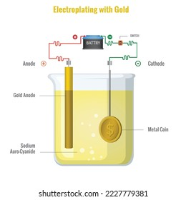
Electroplating
Electroplating is a technique in which an electric current is used to coat a thin metal layer onto the surface of another metal or conductive material, improving is appearance, corrosion resistance,
Theory
Electroplating is a process where an electric current is passed through an electrolyte solution containing metal ions
The term to be plated serves as the cathode, attracting the positively charged metal ions from the solution. These ions receive electrons (undergo reduction) at the cathode surface and form a thin, uniform metal coating
At the same time, metal atoms from the anode dissolve into the solution as ions replenishing the metal ion concentration in the electrolyte
This cycle ensures a metal layer is deposited on the base metal

Slide 42
Gold plating
Before gold plating, the metal surface is first cleaned with organic solvents to remove any oil and grease.
It is then treated with dilute HCI or H2SO4 to eliminate surface scales, oxides, and other impurities
The cleaned article is then used as the cathode in the electrolytic cell
Anode: Gold Plate
Cathode: Article To Be Coated
Electrolyte: Aucl4
The electrolyte undergoes ionisation reaction
AuCl₃ → Au³⁺ +3Cl ⁻
At cathode: When current is applied , Au³⁺ migrate toward the cathode and deposited as metallic gold
Au³⁺ +3e⁻ → Au
At Anode :Chloride move toward the gold anode and disolve an equivalent amount of gold, forming Gold Chloride. Au³⁺ +3Cl ⁻ →Au³⁺ +3e⁻
To obtain strong ,smooth and well-adhered gold coating- specific additives like adhesives and gelatin are added the plating bath .
Brighteners - improve the shine of the deposit.
The optimal conditions for high-quality electro deposit are i)Optimum tempeature ii)Buffer solution to mantian pH, iii)Low metal won concentration

Slide 43
Applications
Applied to connectors, circuit boards, and contacts because of gold's superior electrical conductivity and resistance to corrosion and tarnishing
Offers a visually appealing, corrosion-resistant coating to more affordable metals, improving their appearance at a fraction of the cost of solid gold
Used on watches, pens, frames, and decorative items to improve their visual appeal
Electro-less plating
Electro-less plating a chemical technique that deposits a metal coating on a surface without application of an external electric current, it depends on a controlled redox reaction btween the metal ions in the solution and a reducing agent
Metal Ions +Reducing agent → Metal +Oxidised product

Slide 44
Ni plating
Step I Pretreatment and activation
The plating process starts by thoroughly degreasing the surface with organic solvents or alkaline solutions then treating it with acid and to prepare the substrate for optimal adhesion
For stainless steel surfaces activation is done by immersing the material in a hot solution of sulphuric acid diluted 50%
For magnesium alloys, activate achieved by applying a thin layer of ziie of copper onto the surface
Metals like aluminium, copper, and can along with alloys such as directly without requiring prior activation
Non-metallic substrates, such as plastics and glass, are activated by first dipping them in a solutionof Sncl₂ and HCL, then immersing them in a palladium chloride solution.

Slide 45
Step II Preparation of plating bath
Nature of the compound | Name of the compound | Quantity
Coating solution | Nickel chloride | 20
Reducing agent | Sodium hypophosphate | 20
Complexing agent | Sodium succinate | 15
Buffer | Sodiumacctate | 10
Optimum pit | 4.5 | -
Optimum temperature | 93⁰c | -

Slide 46
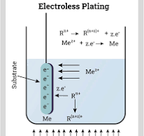
iii)Procedure:
The pre-treated object is submerged in the plating bath a for a specified area,
The following reactions take place,
At cathode: Ni²⁺ +2e⁻ → Ni
At anode: H₂Po₂⁻ +H₂O → H₂Po³⁻ +2H⁺ +2e⁻
Net reaction: Ni²⁺+H₂Po₂⁻ +H₂O → Ni +H₂Po³⁻ +2H⁺
Applications
It is widely used in electronic appliances.
Its polymers are utilized in both decorative and functional applications
It is employed in both domestic and automotive sectors

Slide 47
Surface conversion coating
These coatings are created by chemically or electrochemically treating the surface on metal or alloy, They serve as an excellent foundation for paints, lacquers, and enamels.
Anodising
This process produces a thick oxide coating on base metals or their alloys by using the metal as the anode, in an electro lytic call.
Involves passing moderate direct electric current through a bath in which the metal or alloy is suspended as the anode.
The electrolytes commonly used to facilitate this process include sulphuric acid, chromic acid, phosphoric acid, boric acid, and oxalic acid
Anode (base metal) | Aluminium
Cathode | Cathode
Electrolyte | 3% chromic acid
Temperature | 40°C
Current density | 02-2 mA/cm²

Slide 48
During electrolysis, an oxide coating gradually forms on the aluminium surface through progressive oxidation.
The outer layer of this oxide film can be porous, but it can be sealed by immersing it in boiling water .
This treatment reduces porosity and enhances the corrosion resistance of the film
Uses
Offers a decorative finish available in a range of colours and textures
Utilized in building facades, window frames, and enhance durability and aesthetics
Applied to products such as cookware, smartphones, and sporting goods for both protection and visual appeal

Slide 49
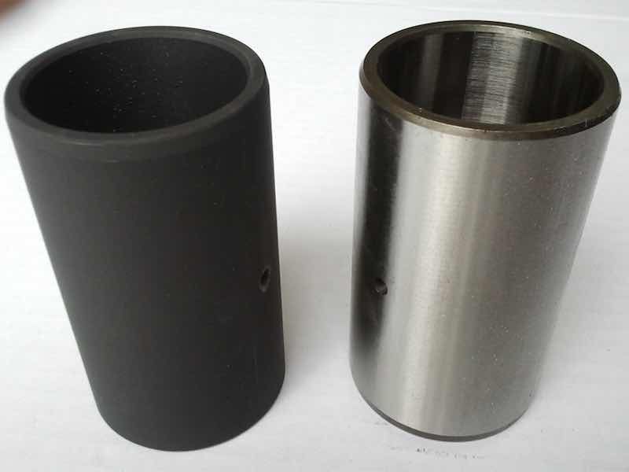
Phosphate coatings
These coatings are formed through a chemical reaction between the base metal and an aqueous solution of phosphoric acid and phosphates.
The phosphates commonly used include those of Fe, Mn, and Zn, often combined with accelerators such as copper salts.
Phosphate coatings are commonly applied to iron, steel, and zinc, and to a lesser extent on Al, Cd, and Sn.
The chemical reaction between the phosphating solution and the base metal forms a surface layer composed of crystalline phosphates of zinc, iron, or manganese.
These coatings are typically grey in colour, but they can be turned black by applying a dye.
Phosphate coatings do not provide full protection against atmospheric corrosion and can reduce welding strength. However, they enhance the film's resistance to humidity.
Uses
Serves as a base coat for paints, lacquers, and oils

Slide 50
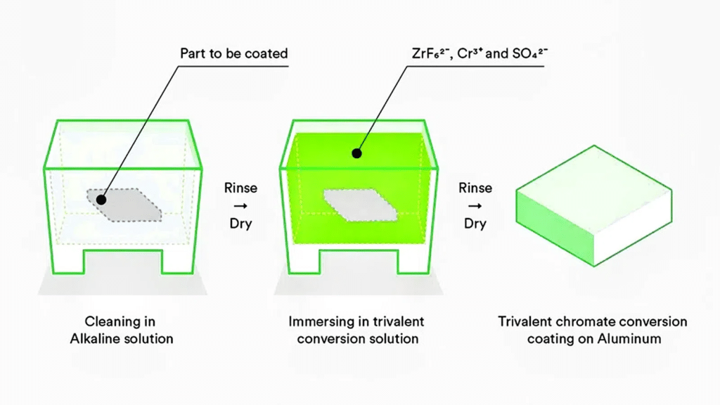
Chromate coatings
These coatings are specifically used to protect Zn. Cd-plated components, as well as Al and Mg
They are formed by first immersing the item in an acid potassium chromate bath, followed by immersion in a neutral chromate solution. The protective effect comes from the formation of a surface film composed of a mixture of Cr (III) and Cr (VI)
By carefully adjusting the chemical composition of the chromate bath, coatings can be produced in a range of colour shades.
The resulting films are amorphous, non-porous, and offer better corrosion resistance than phosphate coatings, though they have relatively low resistance to abrasion

Slide 51
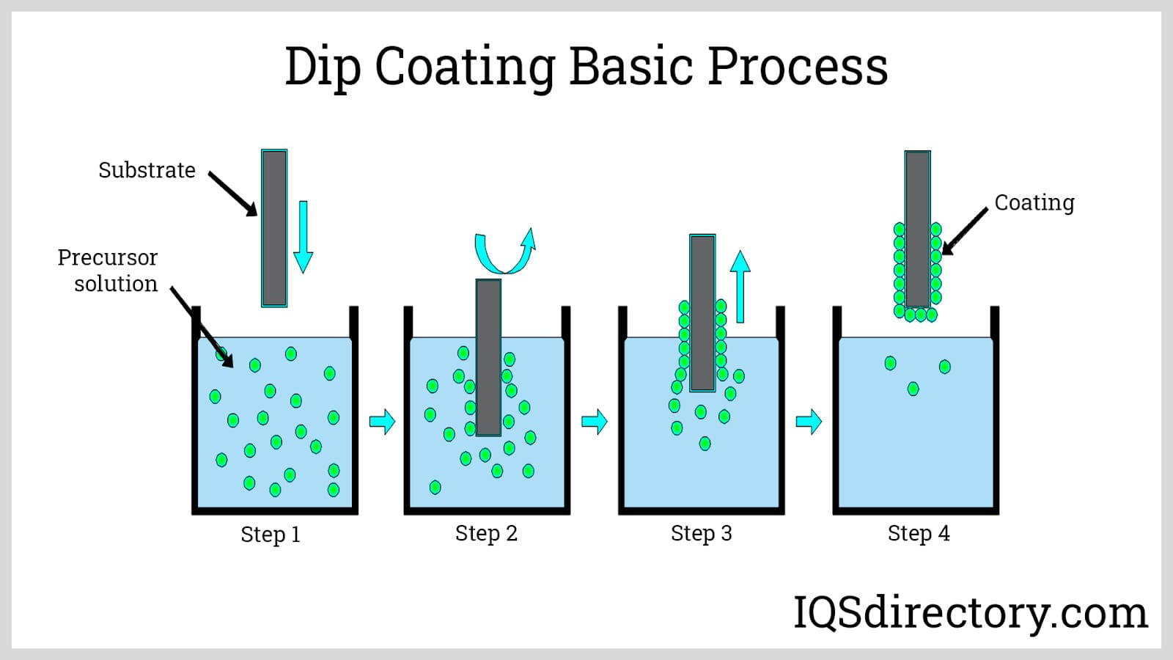
Hot dipping
In this method, the metal to be coated is immersed in a molten bath of the coating metal for a sufficient period, then removed with a layer of the coating metal adhering to its surface.
It is commonly used for applying coatings of low-melting-point metals and alloys, such as Zn, Pb, and terneplate (a Pb-Sn alloy)

Slide 52
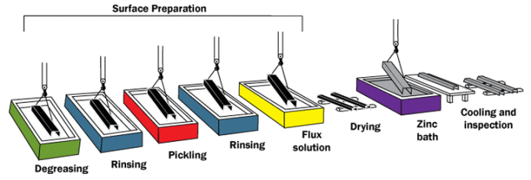
Galvanising
The process of applying a zinc coating is known as galvanizing.
First, the base metal-typically an iron sheet-is pickled in dilute H₂SO₄. to remove any existing oxide layer.
It is then thoroughly rinsed with water.
After cleaning and drying, the iron sheet is immersed in a bath of molten zinc, maintained at 430°C.
To prevent oxidation of the molten zinc, the surface of the bath is covered with an ammonium chloride flux.
A thin layer of the intermetallic compound Fe, Zn, forms at the interface, ensuring strong adhesion of the pure zinc layer to the iron sheet.
Any excess coating metal is removed by passing the sheet through a pair of hot rollers.

Slide 53
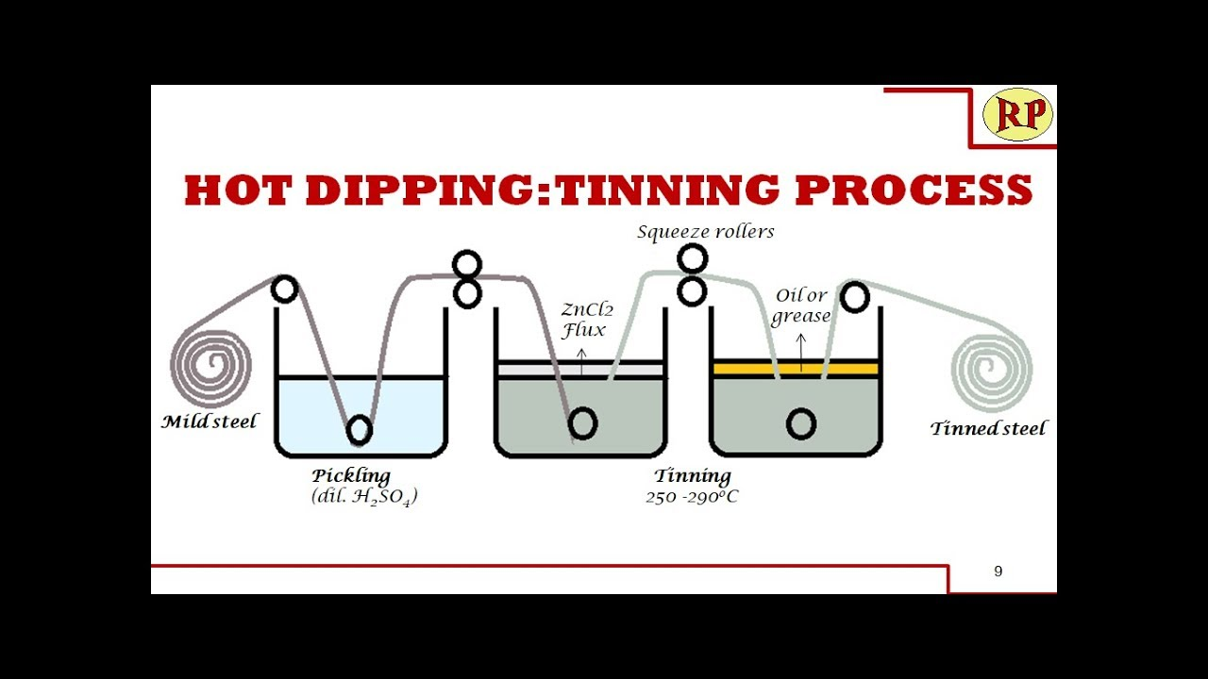
Tinning
The process of applying a tin coating is known as tinning
Initially, the base metal is pickled in dilute H₂SO₄. to remove any oxide layer, then rinsed with water.
After cleaning and drying, it is immersed in a molten tin bath maintained at 235°C.
A layer of ZnCl₂ flux is applied to further clean the metal surface, while palm oil is used to prevent the molten tin from oxidizing
A thin layer of the intermetallic compound FeSn2 forms at the interface, ensuring that the pure tin layer adheres firmly to the iron sheet.
Any excess tin coating is removed by passing the sheet through a pair of bet rollers
Uses-Fit-plated won is used in food containers due to its non-toxic properties

